Slide 1
Information criteria for model (feature) selection
Liang Kuang
2017-04-04
Notes:
http://blog.datadive.net/selecting-good-features-part-iv-stability-selection-rfe-and-everything-side-by-side/

Slide 2
Contents
Overview of feature selection
Information theory (Entropy and IG)
Maximum likelihood estimation (MLE) - optional
Information criteria (AIC, BIC)
Conclusion

Slide 3
Overview of feature selection
1. Filter methods
Baseline approach (low variance)
Correlation coefficient score
Chi square test (non-negative features only)
Information gain (Mutual information)
F-test (only linear dependency, Causality Test)
2. Wrapper methods (model performance)
Forward-backward
Best-first search
Random hill climbing
Recursive feature elimination
Random forest / BSTS
3. Embedded methods (Regularization)
LASSO
Elastic Net
Ridge Regression

Slide 4
Alternative view
1. Scheme I: maximum-relevance selection
Select features that correlate strongest to the classification variable.
E.g. sequential forward, backward or floating selections, mutual information
2. Scheme II: Minimum Redundancy Maximum Relevance (mRMR)
features can be selected to be mutually far away from each other while still having "high" correlation to the classification variable
In this sense, BIC is more recommended than AIC (covered in later slides)

Slide 5
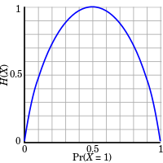
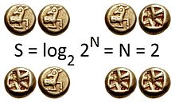
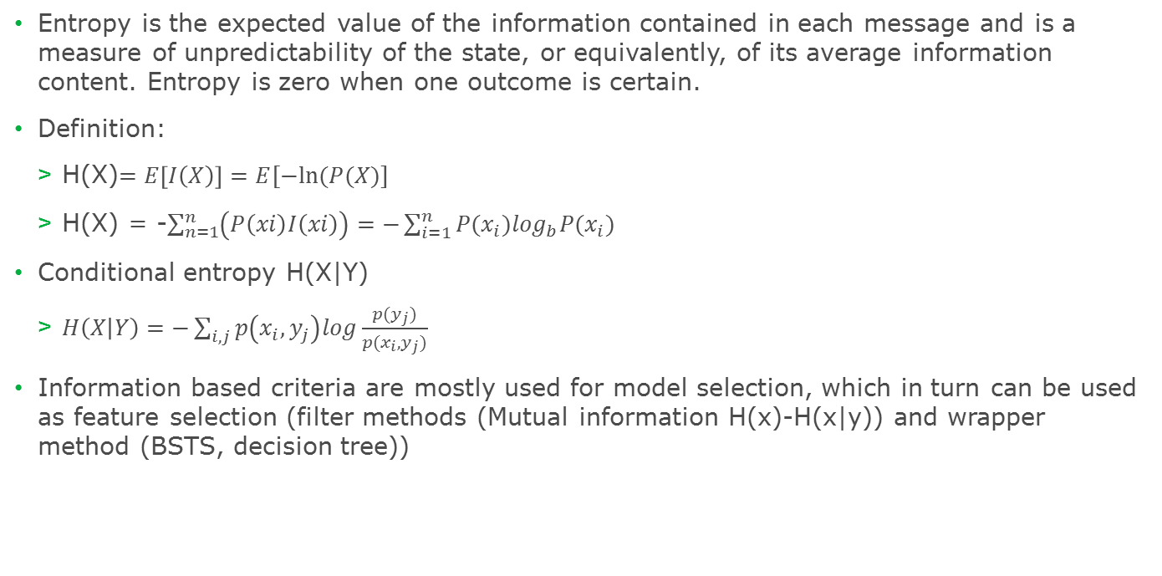
Information theory – Shannon Entropy
Entropy is the expected value of the information contained in each message and is a measure of unpredictability of the state, or equivalently, of its average information content. Entropy is zero when one outcome is certain.
Definition:
H(X)$=E\left[I\left(X\right)\right]=E[−ln⁡(P(X)]$
H(X) = -$\sum_{n=1}^{n}{\left(P\left(xi\right)I\left(xi\right)\right)=−\sum_{i=1}^{n}{P{(x}_{i})\log_{b}P(x_{i})}}$
Conditional entropy H(X|Y)
$H\left(X | Y\right)=−\sum_{i,j}{p\left(x_{i},y_{j}\right)log\frac{p(y_{j})}{p(x_{i},y_{j})}}$
Information based criteria are mostly used for model selection, which in turn can be used as feature selection (filter methods (Mutual information H(x)-H(x|y)) and wrapper method (BSTS, decision tree))

Slide 6
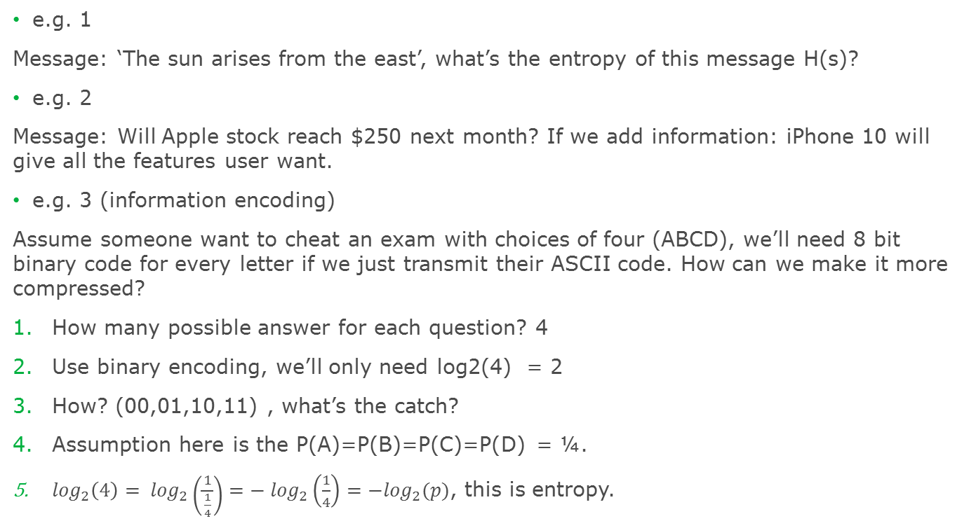
An example to understand entropy
e.g. 1
Message: ‘The sun arises from the east’, what’s the entropy of this message H(s)?
e.g. 2
Message: Will Apple stock reach $250 next month? If we add information: iPhone 10 will give all the features user want.
e.g. 3 (information encoding)
Assume someone want to cheat an exam with choices of four (ABCD), we’ll need 8 bit binary code for every letter if we just transmit their ASCII code. How can we make it more compressed?
How many possible answer for each question? 4
Use binary encoding, we’ll only need log2(4) = 2
How? (00,01,10,11) , what’s the catch?
Assumption here is the P(A)=P(B)=P(C)=P(D) = ¼.
$\log_{2}\left(4\right)= \log_{2}\left(\frac{1}{\frac{1}{4}}\right)=− \log_{2}\left(\frac{1}{4}\right)=−\log_{2}(p)$, this is entropy.

Slide 7
example continued
In reality, the probability for each choice is different. What if P(A) = ¼; P(C) = ½; P(B) = P(D) = 1/8; C has the highest probability, so we use the shorted encoder. B,D use longer encoder.
A: 10
B: 110
C: 0
D: 111
Question: how many bits needed to transmit answers of 200 questions:
A: 200 * ¼ = 50; B: 200 * 1/8 = 25; C: 200 * 1/2 = 100; D: 200*1/8 =25
Total bits: 50 * 2 + 25 * 3 + 100 * 1 + 25 * 3 = 350.
The average bit for each question is 350/200 = 1.75 < 2.
For uniform distribution, entropy is the highest. Random.
Fun facts:
H(English) = 4.03 ; H(French) = 3.98; H(Spanish) = 4.01; H(Germany) = 4.10; H(Russian) = 4.8; H(中文）= 9.65.

Slide 8
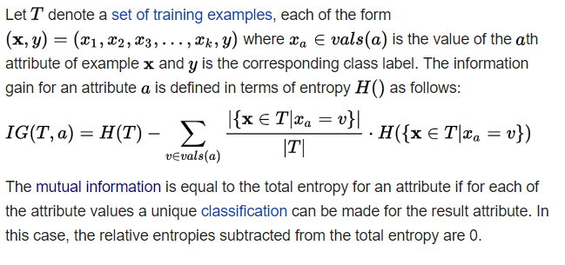
Information gain (a.k.a Mutual information)
Information gain is a synonym for Kullback-Leibler divergence, which is a measure of the non-symmetric difference between two probability distributions P and Q. However, in the context of decision trees, the term is sometimes used synonymously with mutual information, which is the expected value of the Kullback-Leibler divergence of the univariate probability distribution of one variable from the conditional distribution of this variable given the other one.
Formal definition
$$IG\left(T,a\right)=H\left(T\right)−H\left(T | a\right)=H\left(a\right)−H(a|T)$$

Slide 9
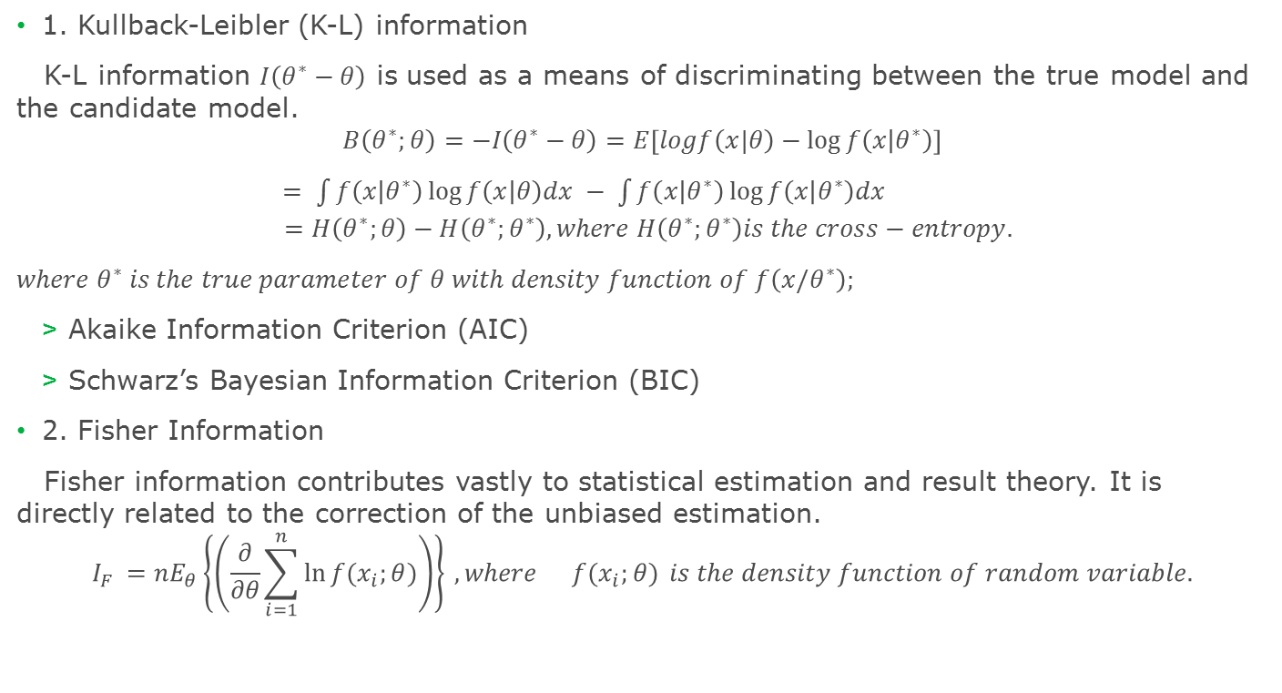
Variable selection with information criteria
1. Kullback-Leibler (K-L) information
K-L information $I\left(θ^{∗}−θ\right)$ is used as a means of discriminating between the true model and the candidate model.
$$B\left(θ^{∗};θ\right)=−I\left(θ^{∗}−θ\right)=E\left[logf\left(x|θ\right)−\log{f\left(x | θ^{∗}\right)}\right]$$
$= \int{f\left(x | θ^{∗}\right)\log{f\left(x | θ\right)dx − \int{f\left(x | θ^{∗}\right)\log{f\left(x | θ^{∗}\right)dx }}}}$
$$=H\left(θ^{∗};θ\right)−H\left(θ^{∗};θ^{∗}\right),where H\left(θ^{∗};θ^{∗}\right)is the cross−entropy.$$
${where θ}^{∗} is the true parameter of θ with density function of f\left(x/θ^{∗}\right);$
Akaike Information Criterion (AIC)
Schwarz’s Bayesian Information Criterion (BIC)
2. Fisher Information
Fisher information contributes vastly to statistical estimation and result theory. It is directly related to the correction of the unbiased estimation.
$$I_{F }=nE_{θ}\left\{\left(\frac{∂}{∂θ}\sum_{i=1}^{n}{\ln{f(x_{i};θ)}}\right)\right\} , where{f(x_{i};θ)} is the density function of random variable.$$

Slide 10
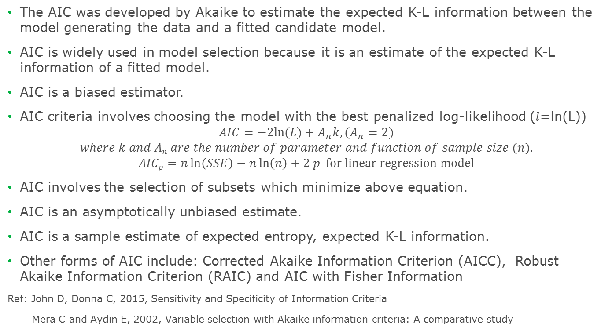
Akaike Information Criterion
The AIC was developed by Akaike to estimate the expected K-L information between the model generating the data and a fitted candidate model.
AIC is widely used in model selection because it is an estimate of the expected K-L information of a fitted model.
AIC is a biased estimator.
AIC criteria involves choosing the model with the best penalized log-likelihood ($l$=ln(L))
$$AIC=−2ln⁡(L)+A_{n}k, (A_{n}=2)$$
$$where k and An are the number of parameter and function of sample size (n).$$
$$AICp=n\ln\left(SSE\right)−n\ln\left(n\right)+2 p for linear regression model$$
AIC involves the selection of subsets which minimize above equation.
AIC is an asymptotically unbiased estimate.
AIC is a sample estimate of expected entropy, expected K-L information.
Other forms of AIC include: Corrected Akaike Information Criterion (AICC), Robust Akaike Information Criterion (RAIC) and AIC with Fisher Information
Ref: John D, Donna C, 2015, Sensitivity and Specificity of Information Criteria
Mera C and Aydin E, 2002, Variable selection with Akaike information criteria: A comparative study

Slide 11
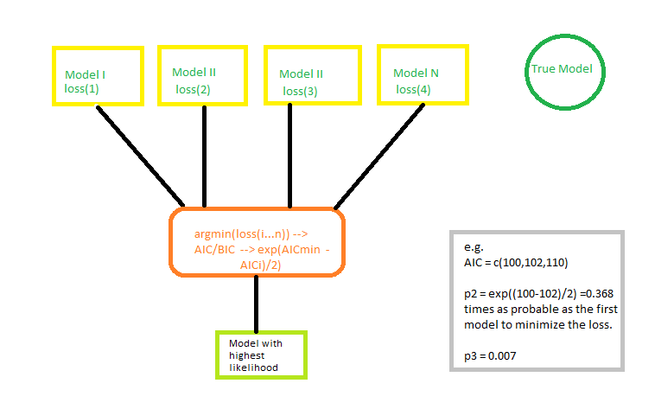
How to apply AIC in practice
We cannot choose with certainty, because we do not know f. Akaike (1974) showed, however, that we can estimate, via AIC, how much more (or less) information is lost by g₁than by g₂. The estimate, though, is only valid asymptotically; if the number of data points is small, then some correction is often necessary (see AICc, below).

Slide 12
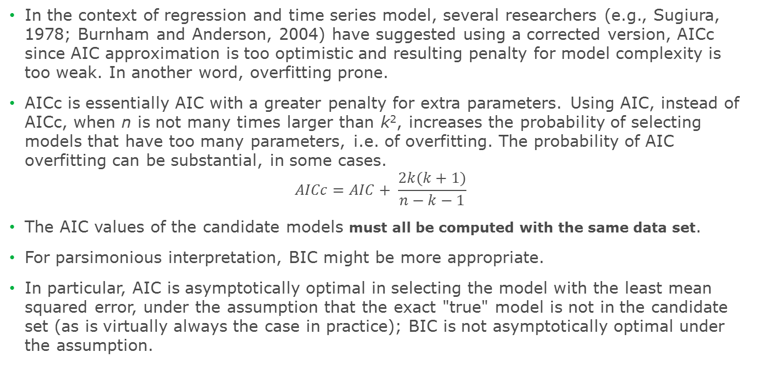
Limitations about AIC
In the context of regression and time series model, several researchers (e.g., Sugiura, 1978; Burnham and Anderson, 2004) have suggested using a corrected version, AICc since AIC approximation is too optimistic and resulting penalty for model complexity is too weak. In another word, overfitting prone.
AICc is essentially AIC with a greater penalty for extra parameters. Using AIC, instead of AICc, when n is not many times larger than k², increases the probability of selecting models that have too many parameters, i.e. of overfitting. The probability of AIC overfitting can be substantial, in some cases.
$$AICc=AIC+ \frac{2k(k+1)}{n−k−1}$$
The AIC values of the candidate models must all be computed with the same data set.
For parsimonious interpretation, BIC might be more appropriate.
In particular, AIC is asymptotically optimal in selecting the model with the least mean squared error, under the assumption that the exact "true" model is not in the candidate set (as is virtually always the case in practice); BIC is not asymptotically optimal under the assumption.

Slide 13
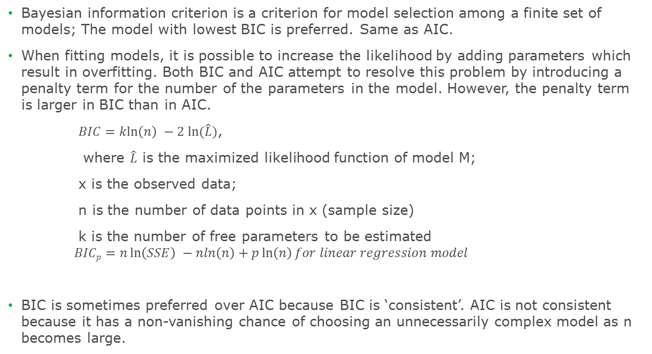
Bayesian Information Criterion (BIC, also as SIC)
Bayesian information criterion is a criterion for model selection among a finite set of models; The model with lowest BIC is preferred. Same as AIC.
When fitting models, it is possible to increase the likelihood by adding parameters which result in overfitting. Both BIC and AIC attempt to resolve this problem by introducing a penalty term for the number of the parameters in the model. However, the penalty term is larger in BIC than in AIC.
$BIC=\operatorname{kln}\left(n\right) −2 ln⁡(\hat{L})$,
where $\hat{L}$ is the maximized likelihood function of model M;
x is the observed data;
n is the number of data points in x (sample size)
k is the number of free parameters to be estimated
$$BICp=n\ln\left(SSE\right) −nln\left(n\right)+p\ln\left(n\right)for linear regression model$$
BIC is sometimes preferred over AIC because BIC is ‘consistent’. AIC is not consistent because it has a non-vanishing chance of choosing an unnecessarily complex model as n becomes large.

Slide 14

Summary of information criteria
Criterion | Penalty weight | Emphasis | Consistent? | Likely Kind of Error
AIC | An = 2 | Good future prediction | No | Overfitting
Adjusted BIC | An = ln(n+2/24) | Depends on n | Yes | Depends on n
BIC | An = ln(n) | Parsimonious model | Yes | Underfitting
CAIC | An = ln(n+1) | Parsimonious model | Yes | Underfitting
$$AIC=−2ln⁡(L)+A_{n}k$$

Slide 15
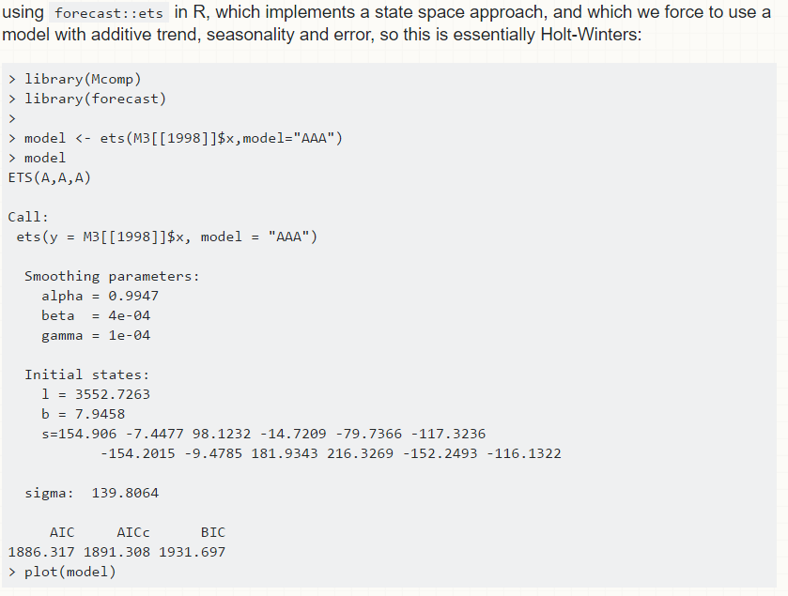
Example

Slide 16
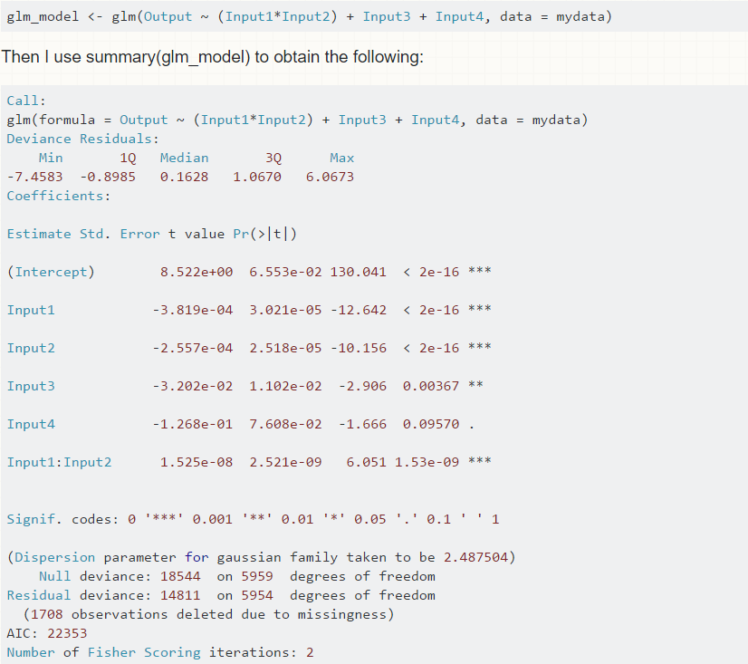

Slide 17
Conclusion
Information criteria is embedded in all the model selection algorithms which select variables as byproduct of the best model
AIC and similar criteria often risk choosing too large a model
BIC and similar criteria often risk choosing too small a model
For small n, the most likely error is under fitting, so the criteria with lower under fitting rats, such as AIC often seem better.
For larger n, the most likely error is overfitting, so more parsimonious criteria, such as BIC often seem better.
However, the choice of ‘n’ become large depends on numerous aspects of the situation.
Some researcher suggest using a BIC-preferred model as a minimum size and the AIC-preferred model as a maximum.
The further choice depends on other kinds of fit criteria, on theory, or on subjective inspection of the results.
Beyond this, theory and judgement are needed.

Slide 18


Slide 19
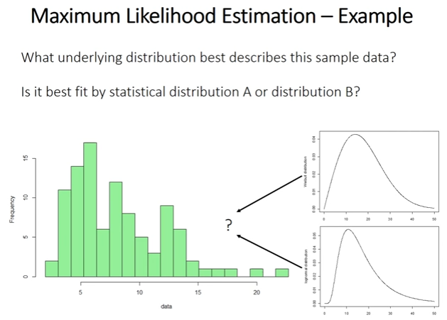
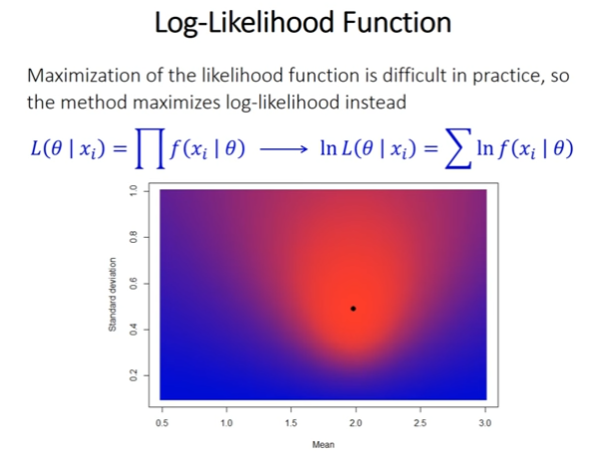
Maximum likelihood principle
Given a dataset choose the parameter(s) of the model in such a way that the data are most likely.
https://www.statlect.com/fundamentals-of-statistics/normal-distribution-maximum-likelihood

Slide 20
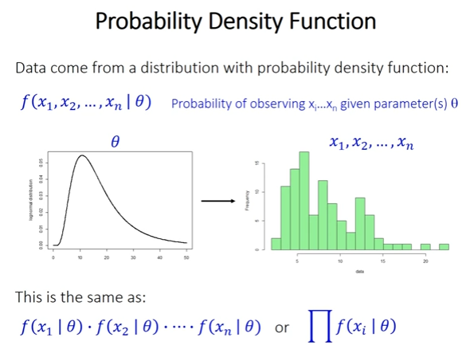
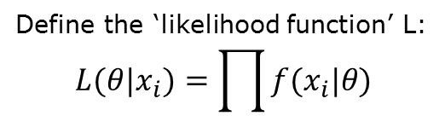
Maximum likelihood principle
Define the ‘likelihood function’ L:
$$L(θ|x_{i})=\prod{f(x_{i}|θ)}$$
https://www.statlect.com/fundamentals-of-statistics/normal-distribution-maximum-likelihood

Slide 21
